Slide 1
Storage Class and Enum Datatypes

Slide 2
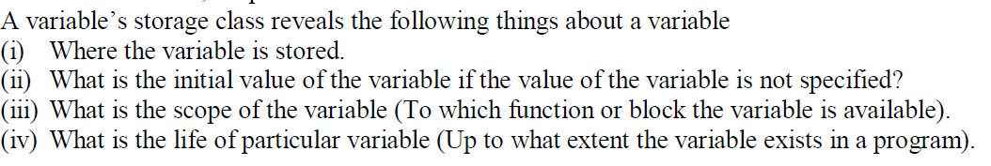
Storage Class:
It provide more information about variables and functions.
Four types of Storage calss in C:
Auto
Static
Extend
Register

Slide 3
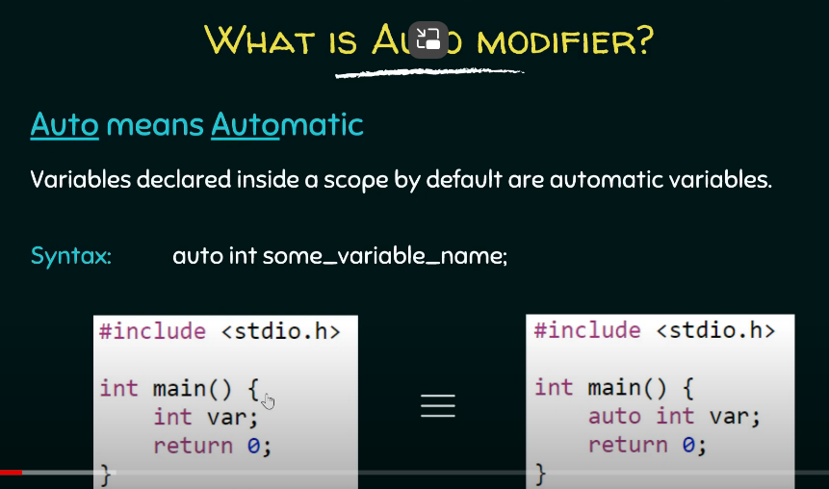

Slide 4
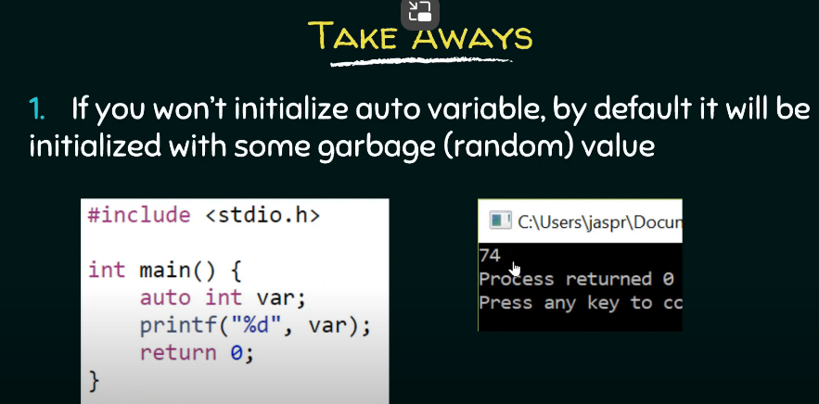

Slide 5
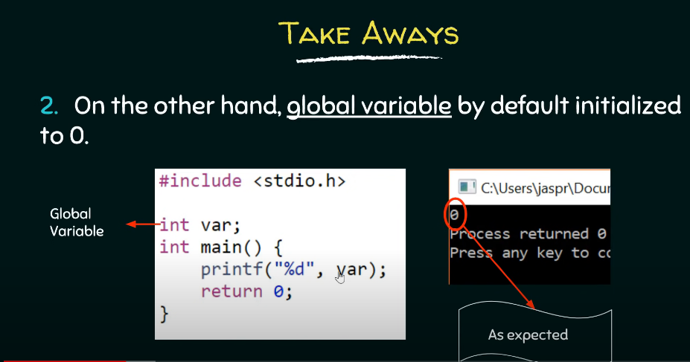

Slide 6
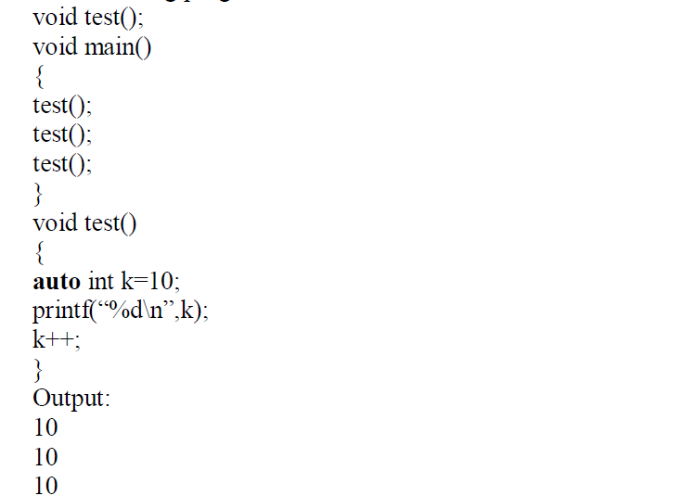

Slide 7
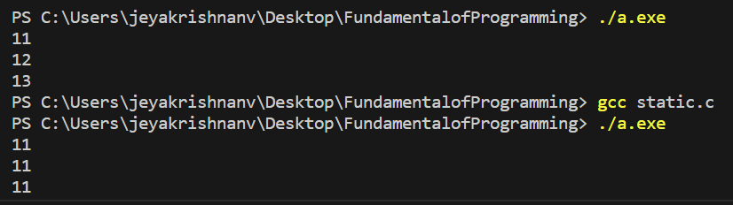
#include<stdio.h>
void fun()
{
auto int a=10;
//static int a=10;
++a;
printf("%d\n",a);
}
void main()
{
fun();
fun();
fun();
}

Slide 8
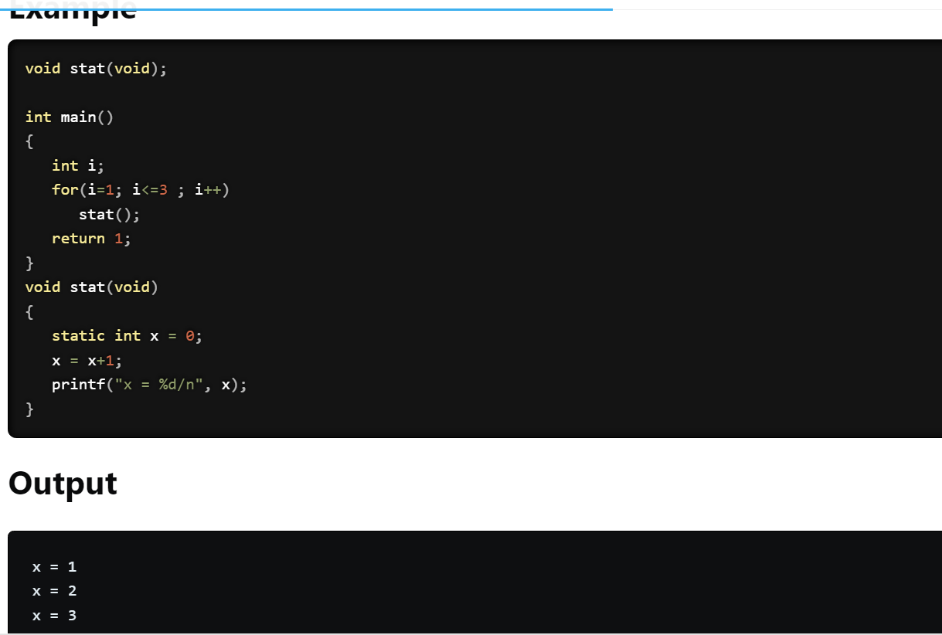

Slide 9
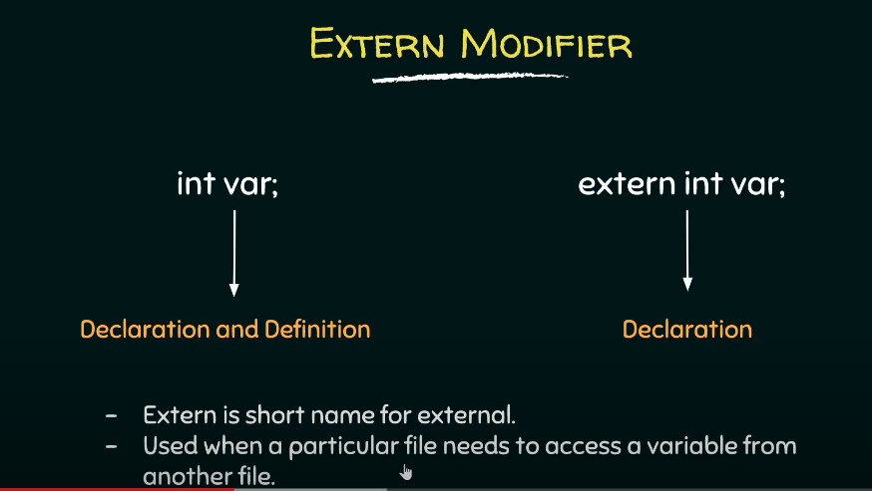

Slide 10
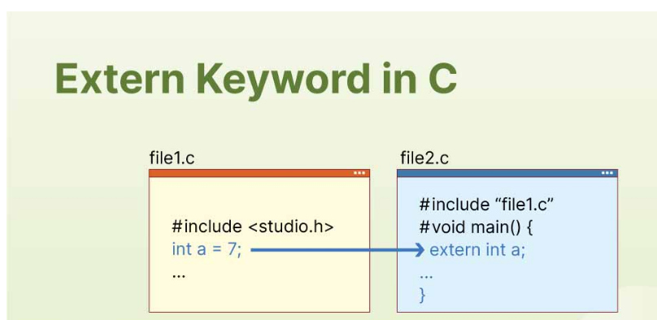

Slide 11
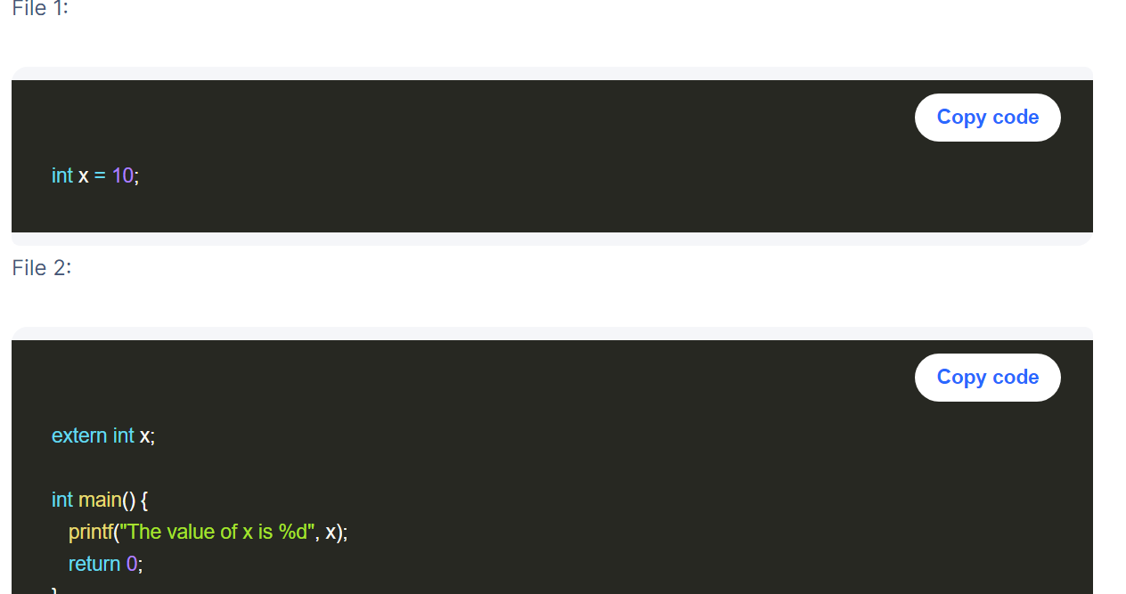

Slide 12
#include<stdio.h>
#include "other"
extern int a;
//auto int b;
void main()
{
// auto int a;// local value declaration is possible
// int c=10;// default all variable declaration are auto
//printf("%d",a);
//register int b;
//printf("\n %d",b);
printf("%d",a);
//printf("%d",c);
}
Other File
Int a=5

Slide 13
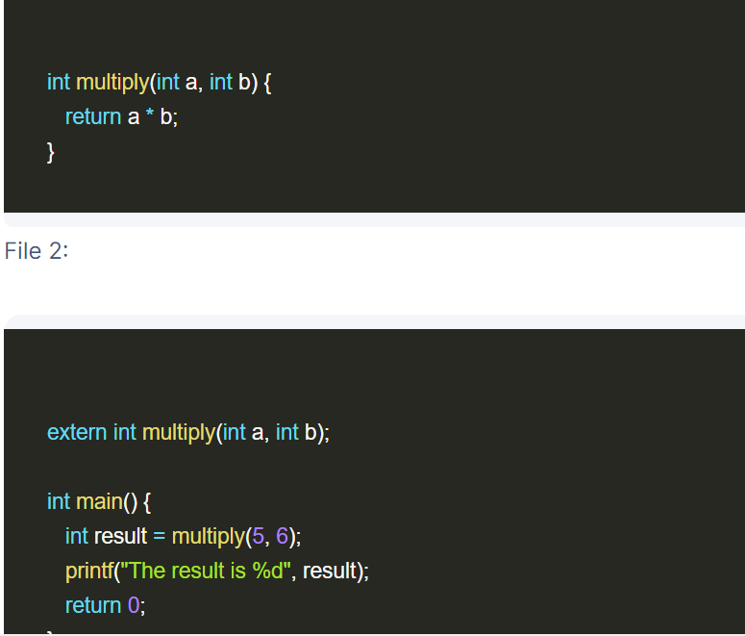

Slide 14
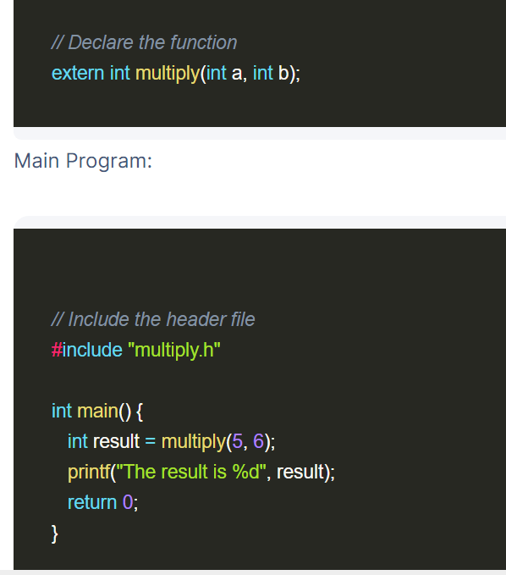

Slide 15
File two:
int multiply(int a, int b) {
return a * b;
}
#include<stdio.h>
#include "externfunction.h"
extern int multiply(int a, int b);
int main() {
int result = multiply(5, 6);
printf("The result is %d", result);
return 0;
}

Slide 16
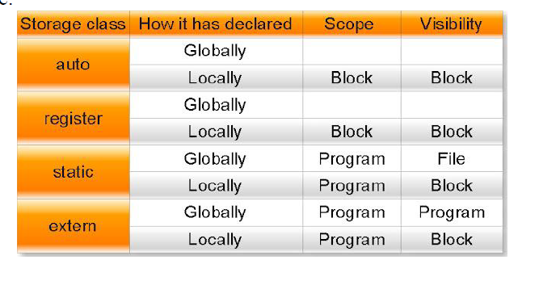
s

Slide 17
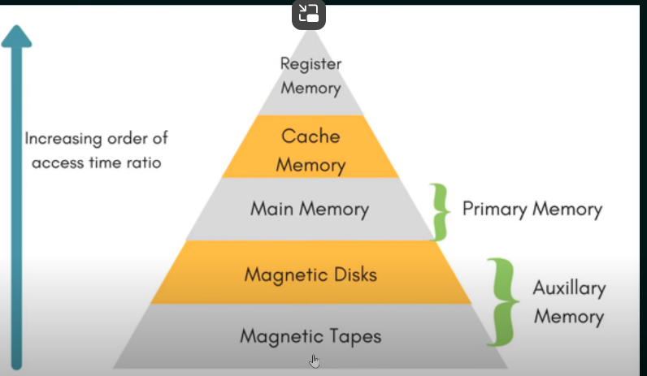

Slide 18
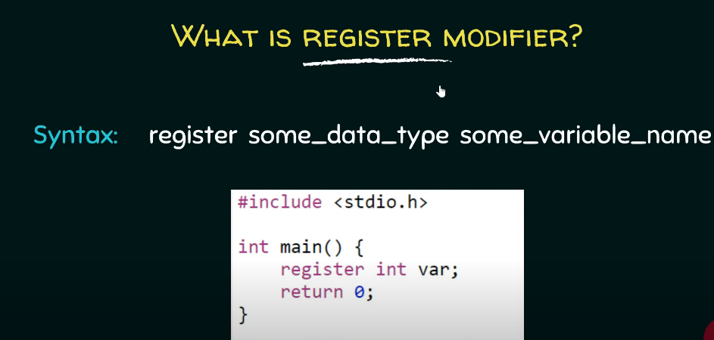

Slide 19
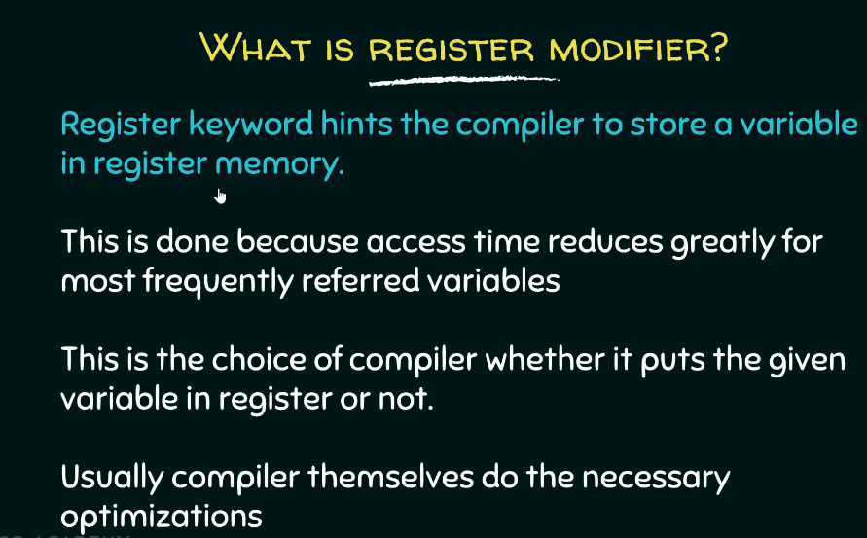

Slide 20
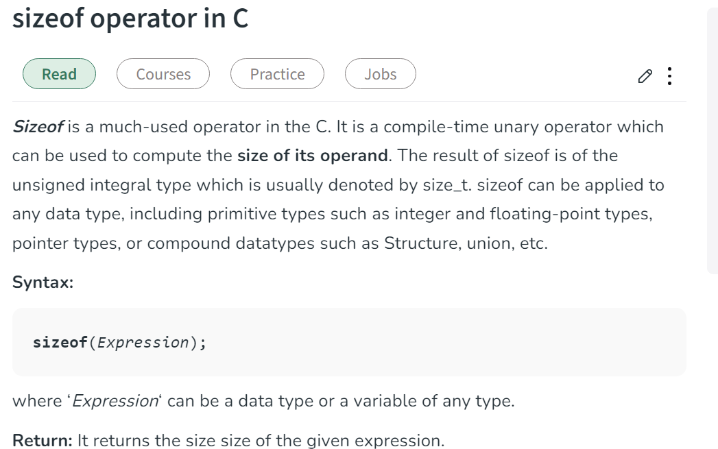

Slide 21
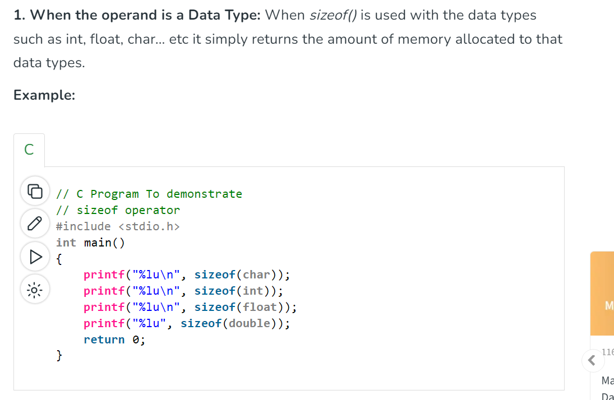
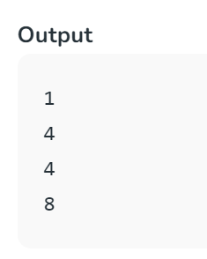

Slide 22
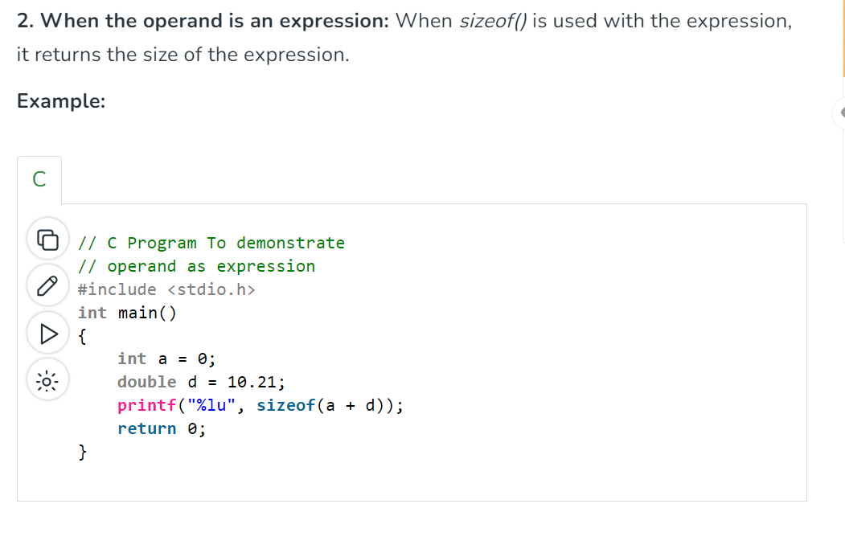
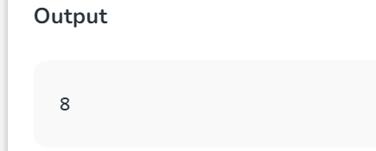

Slide 23
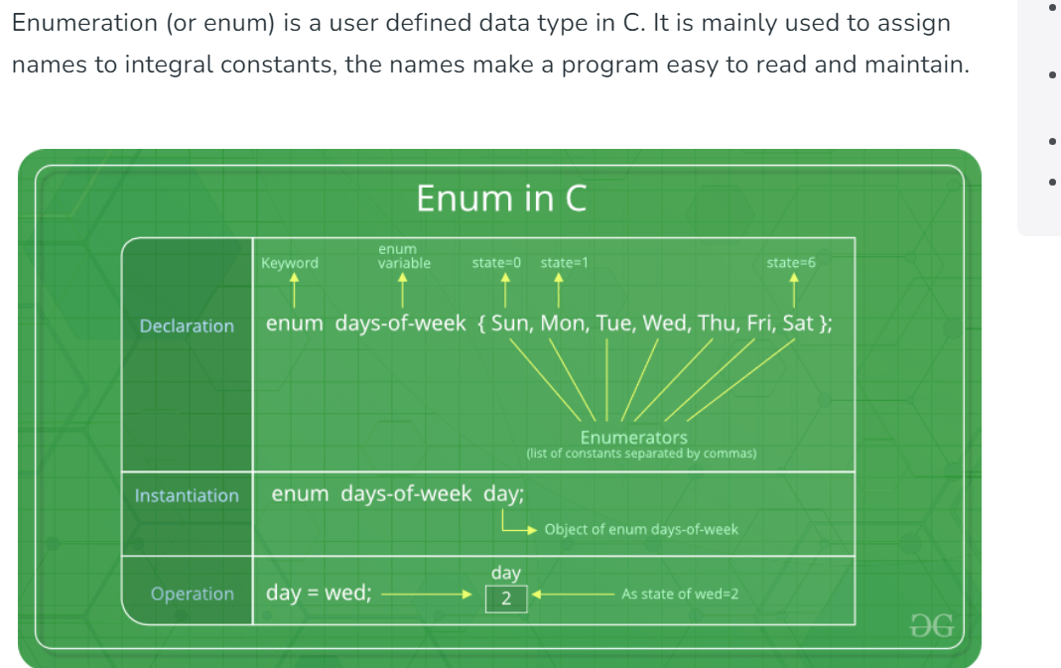

Slide 24
#include<stdio.h>
enum week{Mon, Tue, Wed, Thur, Fri, Sat, Sun};
int main()
{
enum week day;
day = Mon;
printf("%d",day);
return 0;
}
/*enum year{Jan, Feb, Mar, Apr, May, Jun, Jul,
Aug, Sep, Oct, Nov, Dec};
int main()
{
int i;
for (i=Jan; i<=Dec; i++)
printf("%d ", i);
return 0;
}*/

Slide 25
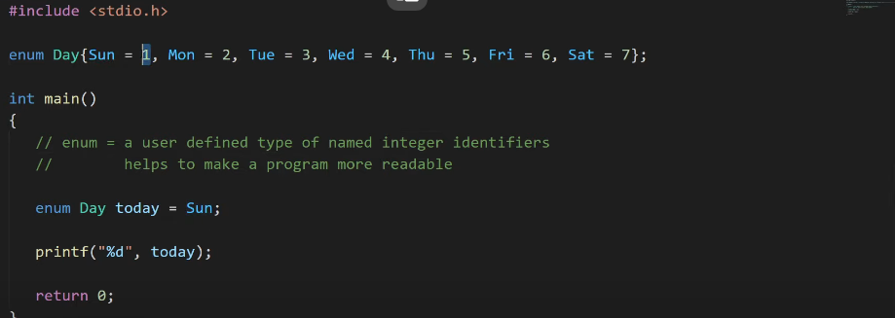

Slide 26
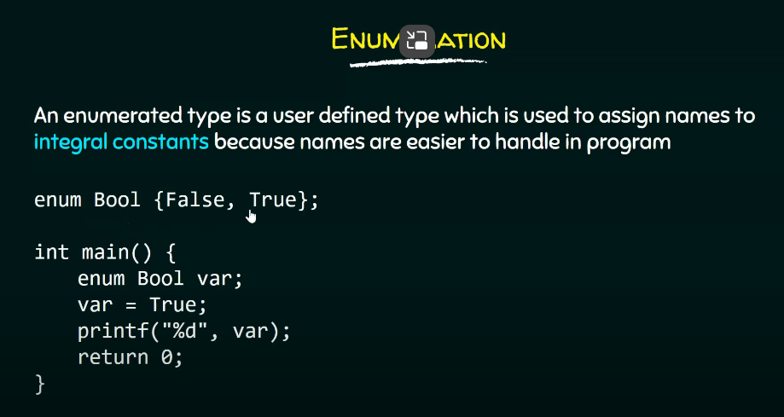

Slide 27
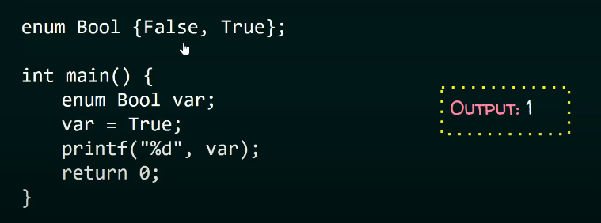

Slide 28
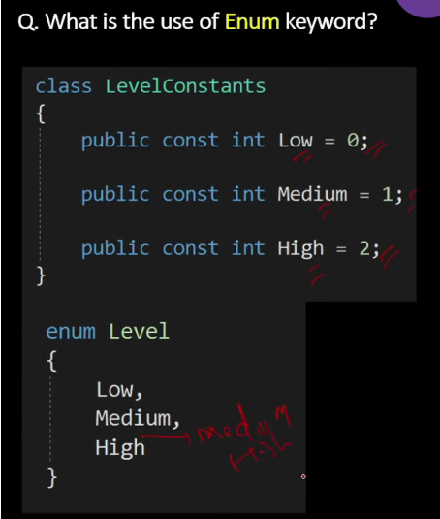

Slide 29
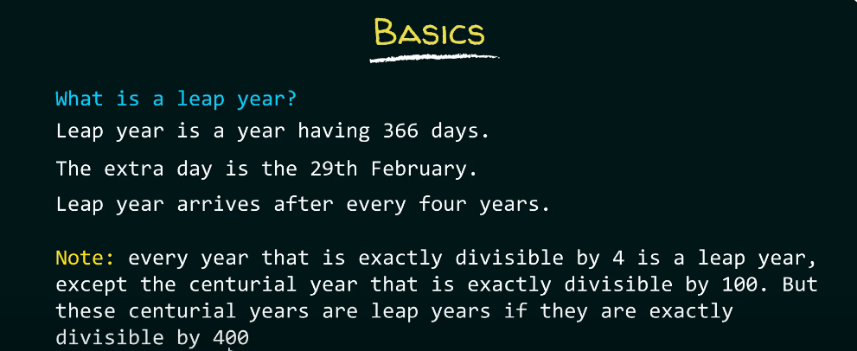

Slide 30
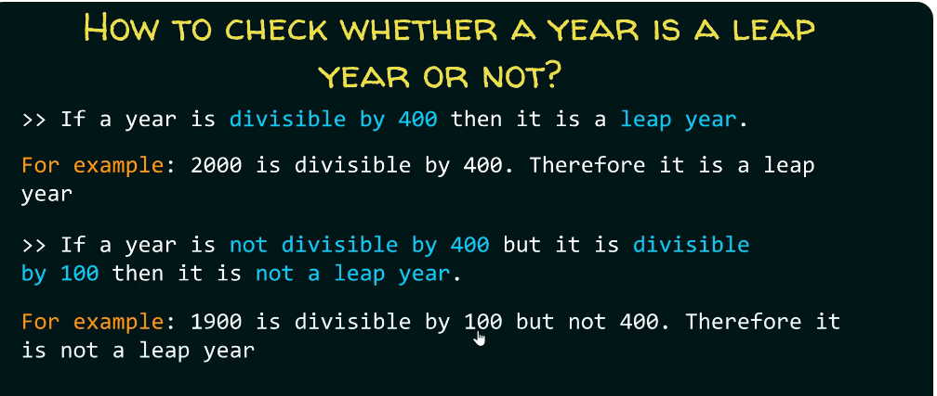

Slide 31
Thank You!!

